Slide 1
HOSTEL MANAGEMENT SYSTEM
Under the Guidance of
Mr. Santhosh Mali

Slide 2
Name : JEEVA RAJAGOPAL Enrolled COURSE : JAVA FULL STACK Developer ENROLLMENT ID : EBEON0821100292

Slide 3
CONTENTS
Introduction.
Technologies used.
Objective.
Home Page.
Admin-Page Login.
Registration-Page.
Hostel Management Details and Update Page Details.
Output Screenshots
Advantages.
Conclusions.

Slide 4
INTRODUCTION
The main objective of the Java Project on Hostel Management System is to manage the details of Beds , Hostel, Rooms, Allotees, Rent.
It is Spring standard project but not pure core spring boot project.
This Project will focus on creating a Admin page and User page .In the user page there will be User login page and Registration page.
The project is totally built at administrative end and thus only the administrator is guaranteed the access.
This project is developed by MVC Architecture.

Slide 5
TECHNOLOGIES USED
Technologies used are
- J2SE - CSS 3
- MySQL 6.0 - JS
- Tomcat Sever 8.5 and more - Bootstrap
- JSP 2.5 and more - Servlet 3.0
- HTML - IDE (Eclipse neon 3)
- Maven

Slide 6
OBJECTIVE
The project is focusing on the Login of Admin and Login of Student.
Where the User can login and as well as register.
It has modules as
Home page
User
Hostel
Room
Warden
Payment List
Allotted Room

Slide 7
Home page
Home page which contains submodules as
Home
Sign Up
- Registration
- Sign Up
- Reset
3. Sign In
- Ask Valid Login with Credentials
- Forget Password
- Sign In
- Sign Up
4. My Profile Page
5. Password
6. Logout

Slide 8
ADMIN-PAGE LOGIN
Admin is the role with the highest level of access to your website.
Admins can control site-wide settings like the design of your website and the homepage layout.
These users have full access to manage the site including adding, deleting and editing all pages and modules.
Only Admin has the rights to change the rooms and update the unique id for the student.
The Admin enter the warden details and student details and about rooms availability.

Slide 9
REGISTRATION PAGE
In Registration Page we will take the user credentials like Name, Password, D.O.B etc....which are required to create account.
To create user account ,he/she would fill the Registration page.
Once the account was created then his data was stored in database and username and password was provided to the user.
Those username and password are required to login to the page.
Without registration the page cannot be accessed by the user.

Slide 10
HOSTEL MANAGEMENT DETAILS AND UPDATE page details
This page consists of the description and details of the website.
Where the user can contact the owner the website through email, phone.
The Website details and its functionalities are added to this page in about us section.
This page consists of all the details we maintain in hostel.

Slide 11
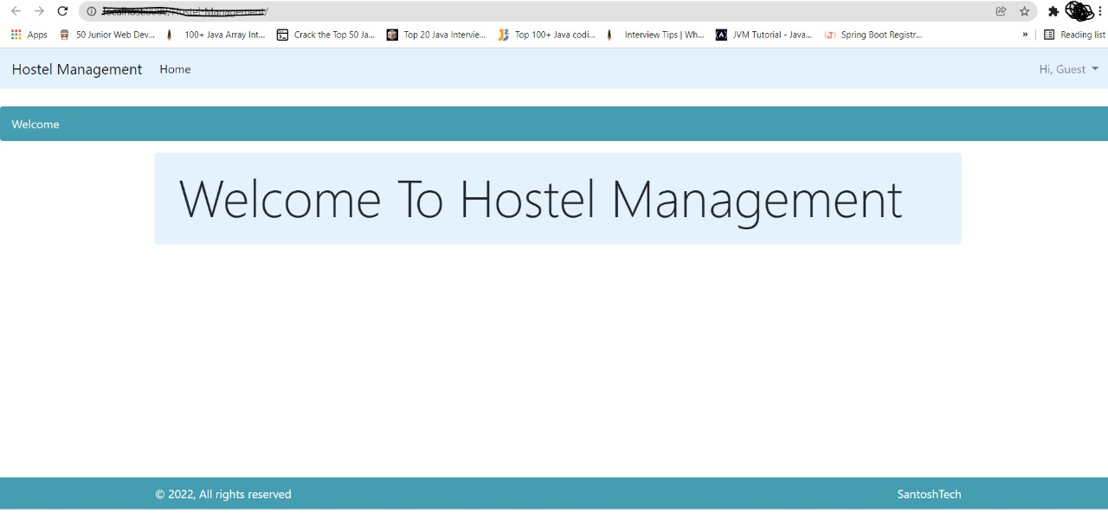
OUTPUT SCREENSHOTS

Slide 12
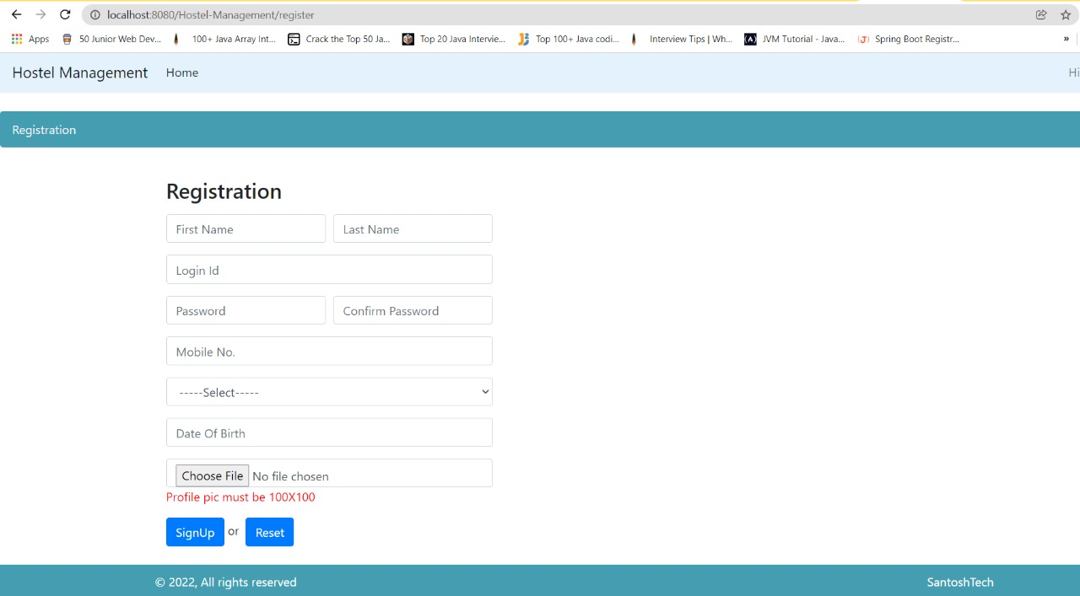
OUTPUT SCREENSHOTS

Slide 13
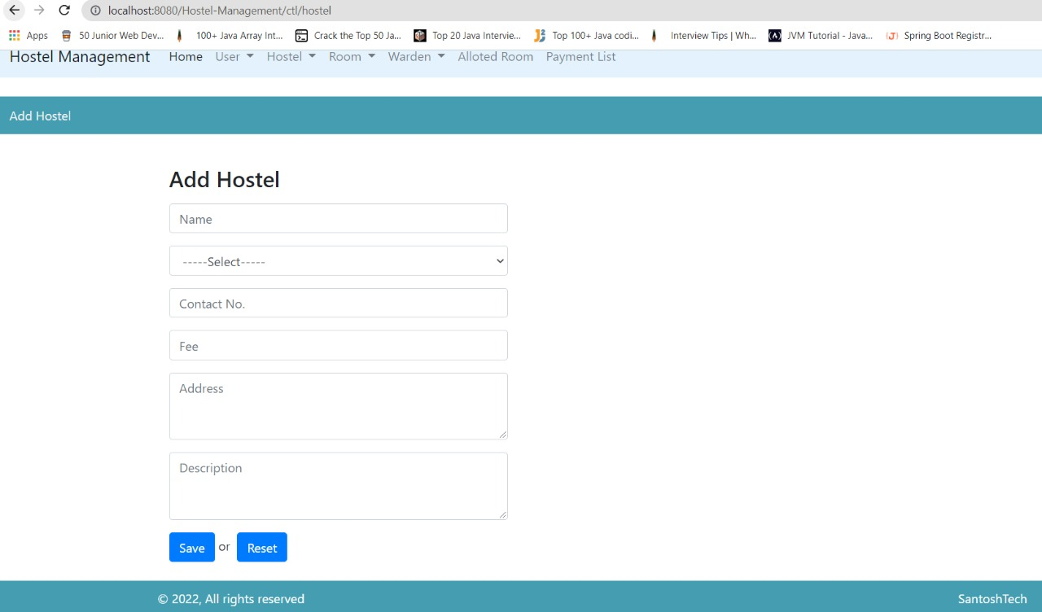
OUTPUT SCREENSHOTS

Slide 14
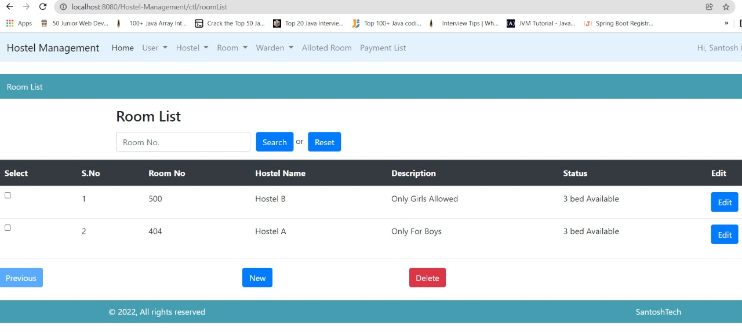
OUTPUT SCREENSHOTS

Slide 15
ADVANTAGES
Object Oriented and High Security.
It save time and cost.
It is secure and Reliable.
Web based solution.
Accurate Student Data Management.
Compile and Interpreted.
Multithreaded, robust and Secure.
High Performance.
Easy and simple to use.

Slide 16
CONCLUSION
Hostel management system is designed to manage all hostel activities like Registration for new, Hostel Admissions, Room, Mess allotment, Hostel stores.
It is user friendly and Customization software for student hostel.
This project is very flexible software and it can be upgraded.

Slide 17
THANK YOU

